Slide 1



















The NSF SecureCloud Project:
Autonomic Cybersecurity for Zero Trust Cloud Computing NYSERNET TNConX webinar March 28, 2019 PI: Casimer DeCusatis, Ph.D. casimer.decusatis@marist.edu
Assistant Professor, Marist College @Dr_Casimer Co-PI: Alan Labouseur, Robert Cannistra, Matt Johnson, Bill Thirsk (CIO)
HVCSC

Slide 2

Overview
Cybersecurity at Marist College
The need for SecureCloud
SecureCloud Architecture Overview
Honeypot and Geolocation Applications
Education & Research SOC Integration
Defending BlockChain Applications
Identity Management and Cloaking Technology (First Packet Authentication, Transport Access Control)
Summary & Future Research Directions

Slide 3
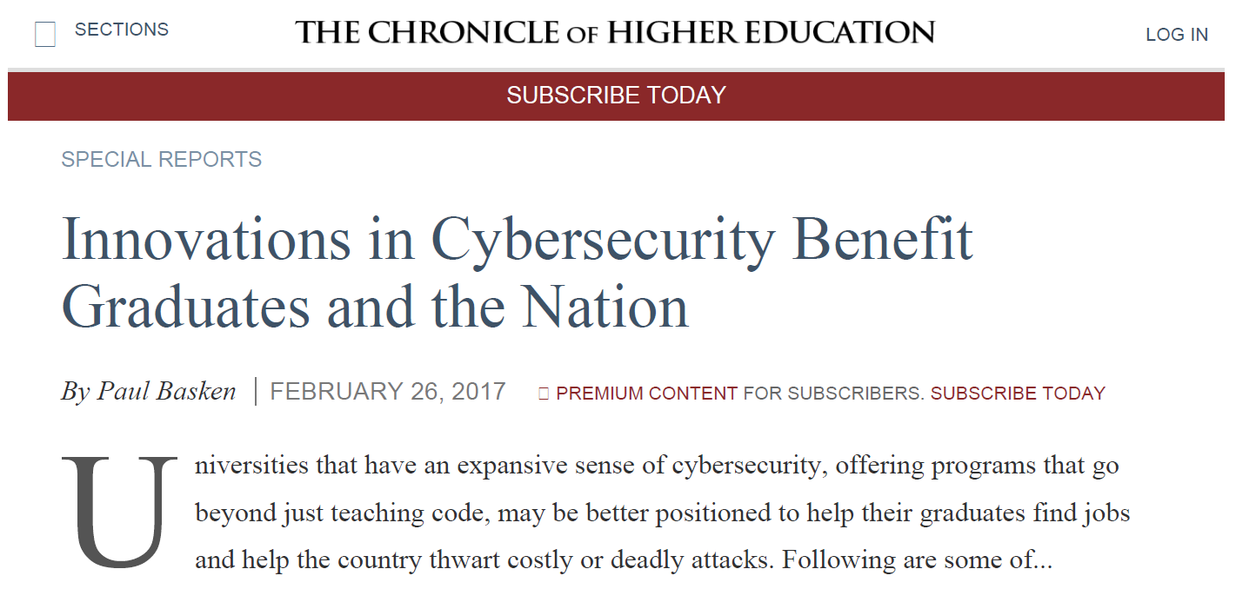

Cybersecurity at Marist College
B.S. degree in Cybersecurity
Hacking & Penetration Testing
Mobile Security
Computer Forensics & Ethical Hacking https://www.marist.edu/computer-science-math/cybersecurity
Minor in Cybersecurity
Education & Research SOC https://patch.com/new-york/midhudsonvalley/ marist-opens-center-cybersecurity-program
Online IDCP Certification from NY State http://idcp.marist.edu/enterprisesystemseducation/cybersecurity.html
Summer high school program for college credit http://ww2.marist.edu/summerinstitutes/cybersecurity/
Marist Innovation Lab on GitHub https://github.com/Marist-Innovation-Lab
Cybersecurity job posting grew 114% from 2011 to 2015, with 86% requiring at least a B.S. degree. 4 year colleges are meeting only about 24% of this demand.

Slide 4
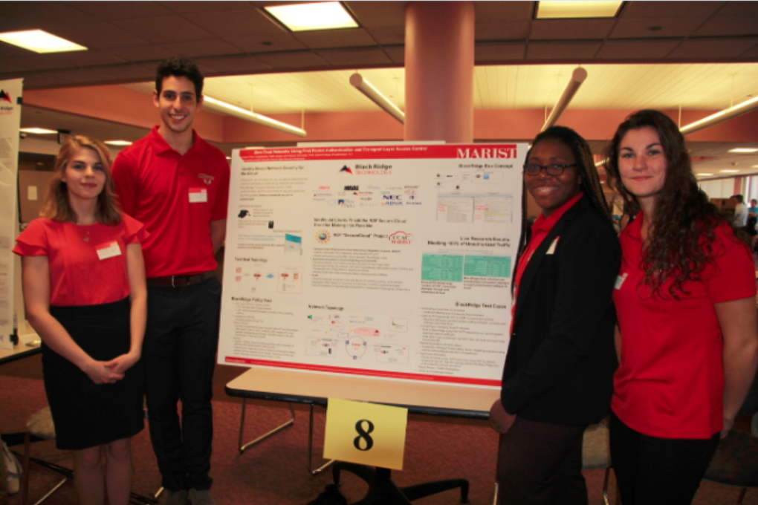

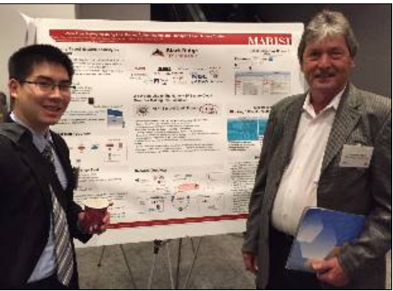
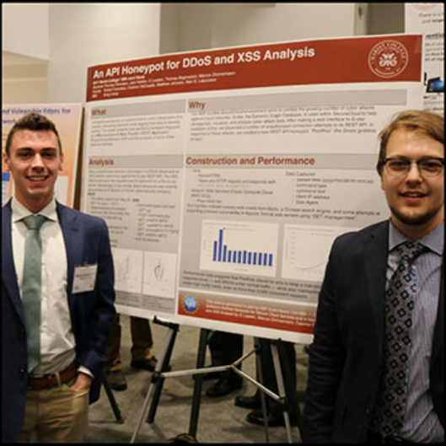
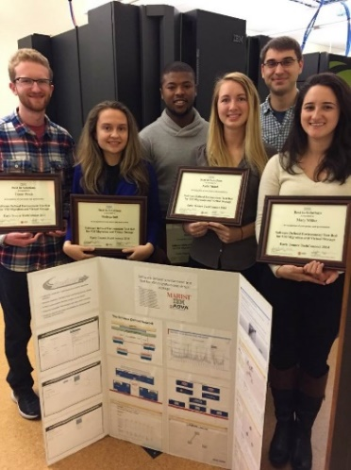
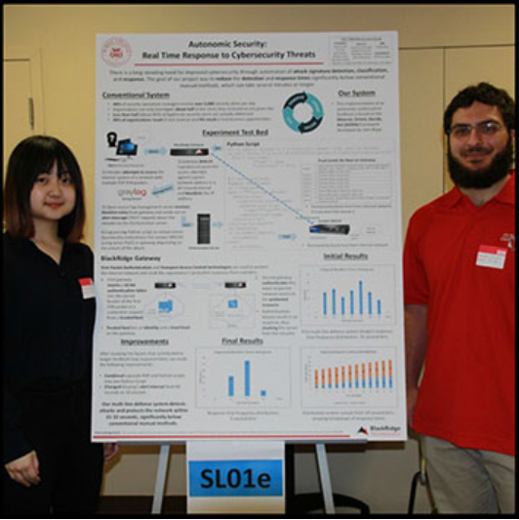
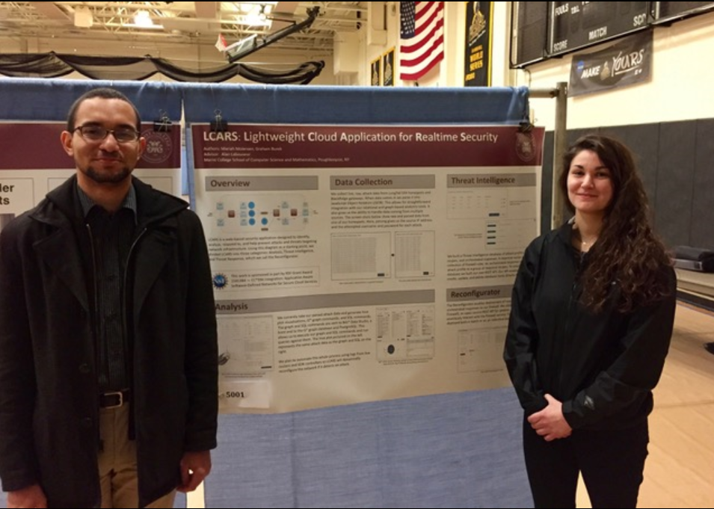
Award Winning Student Research Team
IBM TechConnect 1st Place 2016 1st Place 2017 1st Place 2018
NYIT Cybersecurity Conference
Best Undergraduate Poster 2016 1st place poster award 2017 2nd place poster award 2018 1st place, JP Morgan Chase “code for good” hackathon
MIT IEEE Undergraduate Research Conference

Slide 5
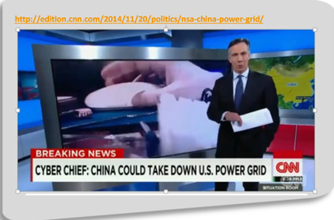

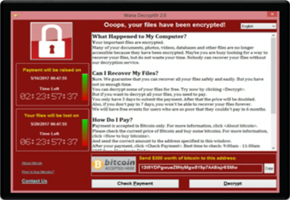
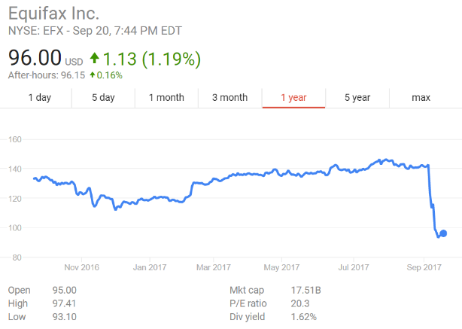





Russian hackers attack Wolf Creek
nuclear power plant in Kansas
WannaCry ransomware shuts down hospitals & re-routes ambulances across the U.K.
Equifax loses data on half the U.S. population, prompting record $17 B of identity theft
Attacks which lock you out of your mobile device increased 18% (now used in 1/3 of all attacks)
Uber loses data on 57 million people; Self-driving cars and Internet of Things are routinely hacked

Slide 6

NSF “SecureCloud” Project
Campus Cyberinfrastructure Data Networking Integration (3 years, $690 K)
Casimer DeCusatis (PI), 4 students, 3 other faculty/CIO co-PI
Industry partners including IBM, Ciena, Brocade, BlackRidge, Cisco
NY State Cloud Computing & Analytic Center (CCAC) at Marist College
Autonomic security for zero trust cloud computing environments
Develop & deploy novel end-to-end security policy for each application
Dynamically monitor the network both within and between data centers (up to 100 km) and change security configuration in response to attacks
Prevent DDoS masking attacks, improve traffic visibility & segregation
Develop & test new code, eventually deploy into production at Marist

Slide 7

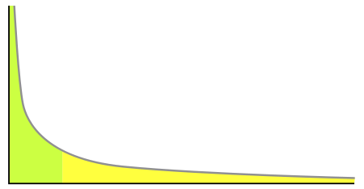






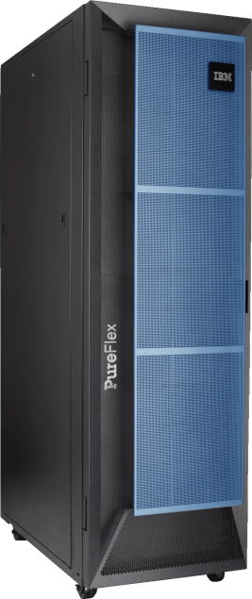


Trust Level | Policy
5 | Forward
4 | Restricted Apps
3 | Redirect
2 | Drop
LCARS SOC LAMP Orchestrator
10G Optical Bypass Switch
Marist LongTail & Honeypots (SSH, SDN,API)
SDN Controller Cloaked
External Threat
BlackRidge FPA with TAC Dynamic Trust Levels
WDM Node C
WDM Node B
Brocade/Vyatta 5600
RFW open source firewall Cisco routers
Untrusted Network
With Ciena Metro Ethernet & WDM
Internal Threat
Blockchain Hyperledger
Authorized User
WDM Node A

Slide 8
Trust Level | Policy
5 | Forward
4 | Restricted Apps
3 | Redirect
2 | Drop
LCARS SOC LAMP Orchestrator
10G Optical Bypass Switch
Marist LongTail & Honeypots (SSH, SDN,API)
SDN Controller Cloaked
External Threat
BlackRidge FPA with TAC Dynamic Trust Levels
WDM Node C
WDM Node B
Brocade/Vyatta 5600
RFW open source firewall Cisco routers
Untrusted Network
With Ciena Metro Ethernet & WDM
Internal Threat
Blockchain Hyperledger
Authorized User
WDM Node A
Notes:
key points: HoneyPots, SOC orchestration, Blockchain, insider threats, External threats: Bleichenbacher

Slide 9
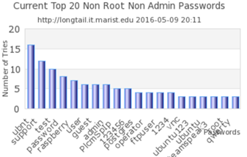
LongTail & Hive Live Updates
http://longtail.it.marist.edu/honey/
IEEE TryCybSi Project, Docker container with LongTail SSH Honeypot http://try.cybersecurity.ieee.org/trycybsi/explore/honeypot
We have deployed 21 SSH honeypots across the Hudson Valley
Collected and analyzed over 41 million data points over a 12 month period, and identified over 100 unique attack patterns

Slide 10




Cyber Threat Intelligence – Marist Honeypot Pantheon
Dolos SDN honeypot
Pandora SSH botnet classifier
Atlas Geolocation
Pasithea graph database API honeypot
A honeypot is… “a security resource whose value lies in being probed, attacked, or compromised.”

Slide 11
Dolos
Dolos was initially designed to mimic an modified Open Daylight (ODL) SDN controller that would deny and log all attempts to access the controller
PHP, Apache 4.2.9; later ported to Python
Collects data including: Source and Destination IP/Port Address, Time of Day, Attempted credentials, OS, Browser
C. DeCusatis, “Fulfilling the potential of SDN”, invited presentation, “Majorca at MIT” conference, Cambridge, MA (July 27-30, 2015)
G. Leaden, M. Zimmermann, C. DeCusatis, and A. Labouseur, “An API Honeypot for DDoS and XSS Analysis”, Proc. IEEE/MIT Undergraduate Research Technology Conference, Cambridge, MA (Nov. 3-5 2017)
C. DeCusatis, A. Labouseur, T. Famularo, J. Heiden, G. Leaden, T. Magnusson, and M. Zimmermann, “An API Honeypot for DDoS and XSS Analysis”, Proc. IBM TechConnect, IBM Pougkeepsie/Yorktown Heights, NY (September 28, 2017)
Notes:
G

Slide 12
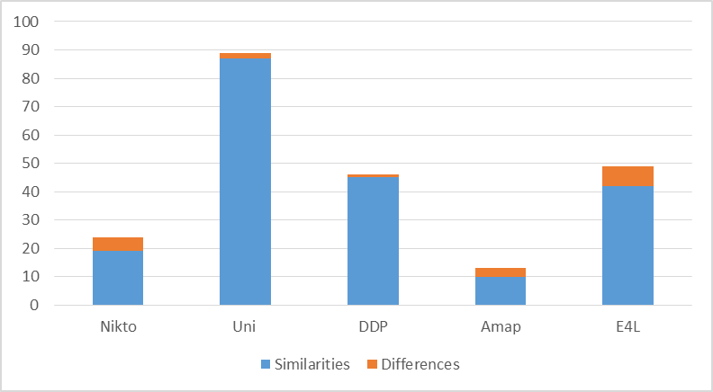
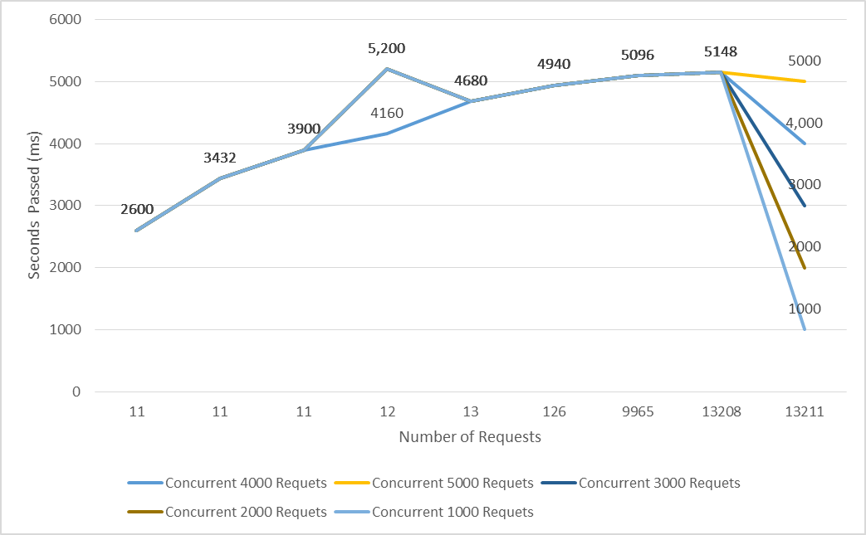
Dolos vs. ODL Fingerprinting & Performance
Lines of code (%)
Percentage lines of code which are the same (Blue) and different (Orange) using different scanning tools
Dolos Apache server response time vs number of requests, for different number of concurrent requests
C. DeCusatis, A. Labouseur, T. Famularo, J. Heiden, G. Leaden, T. Magnusson, and M. Zimmermann, “An API Honeypot for DDoS and XSS Analysis”, Proc. NYIT 7th Annual Cybersecurity Conference, New York, NY; Best Undergraduate Research Paper Award (Sept. 23, 2017) http://www.nyit.edu/events/annual_cybersecurity_conference (last accessed September 2017)
Notes:
G

Slide 13

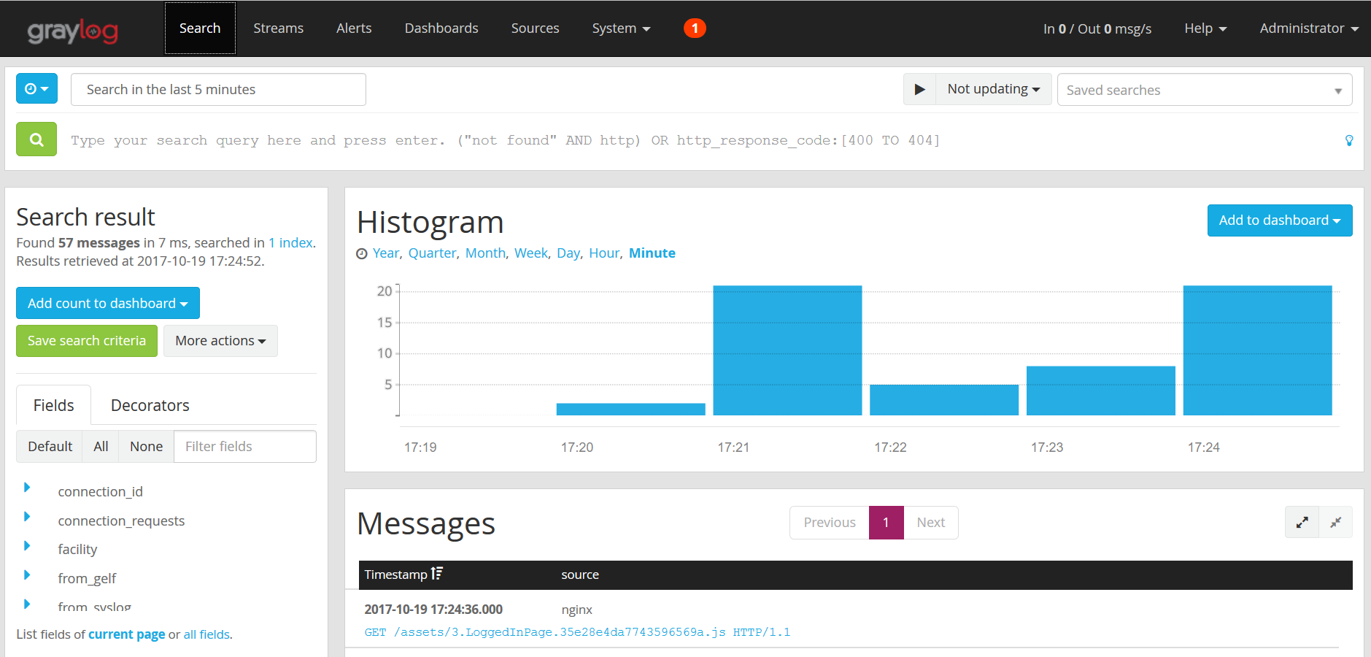
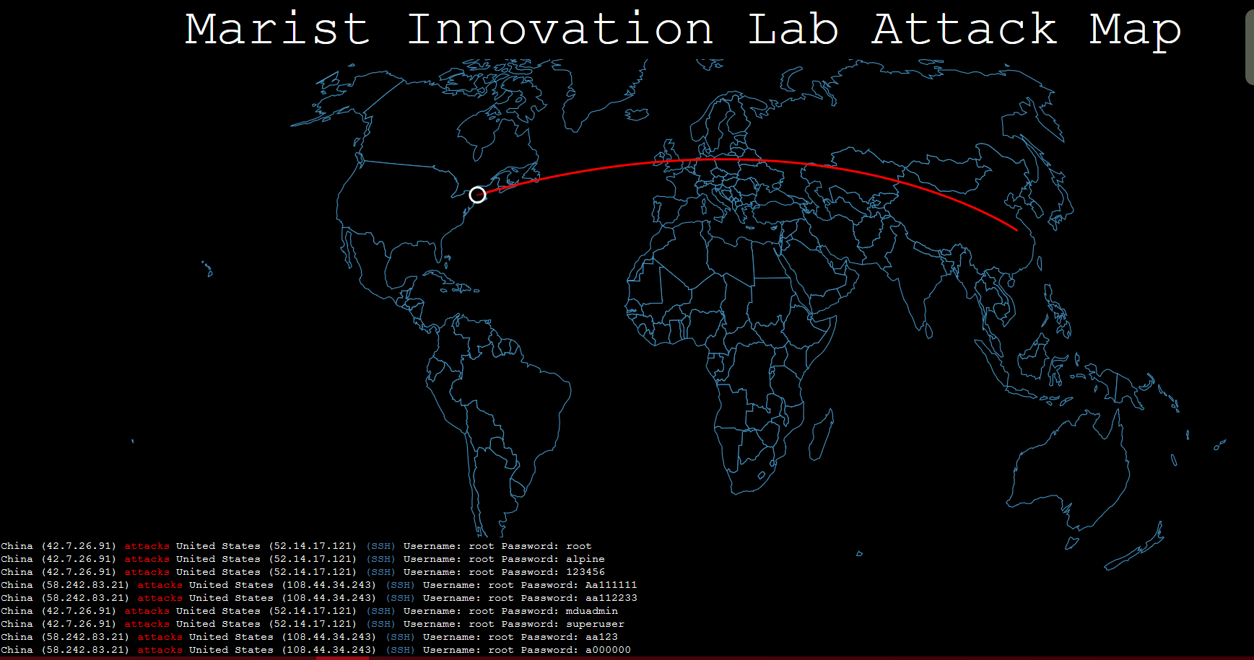
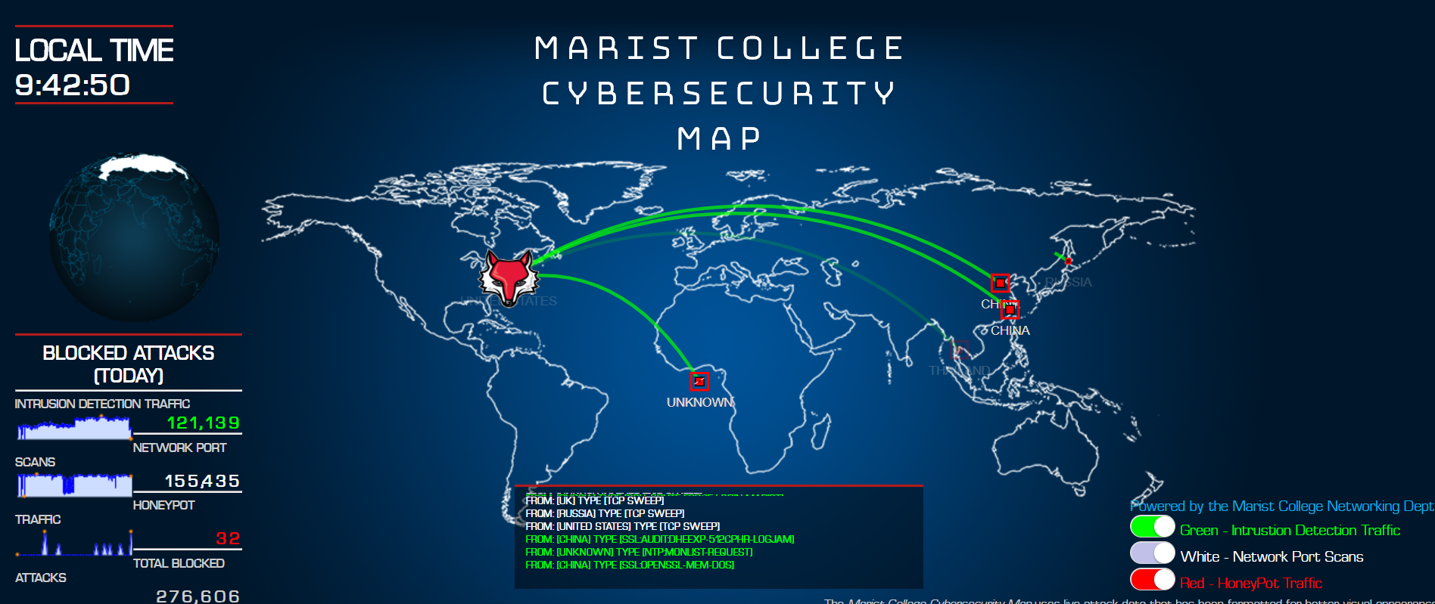
GrayLog (open source log parser) scans syslog data
Marist attack maps with geolocation using MaxMind database

Slide 14
Trust Level | Policy
5 | Forward
4 | Restricted Apps
3 | Redirect
2 | Drop
LCARS SOC LAMP Orchestrator
10G Optical Bypass Switch
Marist LongTail & Honeypots (SSH, SDN,API)
SDN Controller Cloaked
External Threat
BlackRidge FPA with TAC Dynamic Trust Levels
WDM Node C
WDM Node B
Brocade/Vyatta 5600
RFW open source firewall Cisco routers
Untrusted Network
With Ciena Metro Ethernet & WDM
Internal Threat
Blockchain Hyperledger
Authorized User
WDM Node A

Slide 15

Marist Security Operations Center (SOC)
Grand opening September 2018
4 large screen (72”) computers and 32 desktops (both Windows and Mac hardware at each desktop)
Time delayed live data from Marist campus and CCAC security systems
Cloud Security and Graph Analytics https://www.youtube.com/watch?v=Hz_XyIipC2Y&feature=youtu.be
Cybersecurity education, Geolocation, and IBM Qradar https://www.youtube.com/watch?v=VZo9TWKIAbI&feature=youtu.be
15

Slide 16
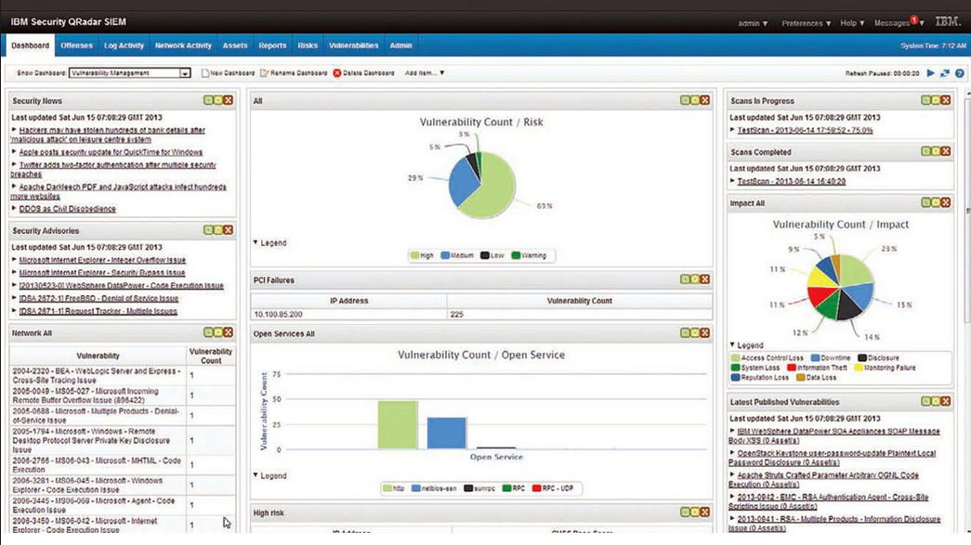
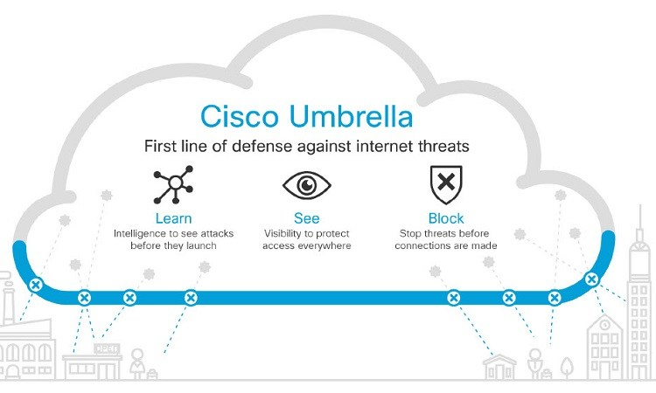
IBM QRadar SIEM for threat detection & management Platform integration with Cisco & Marist code
Cisco Umbrella CloudLock on VMWare, FirePower Threat Defense, OpenDNS, Threat Intelligence

Slide 17

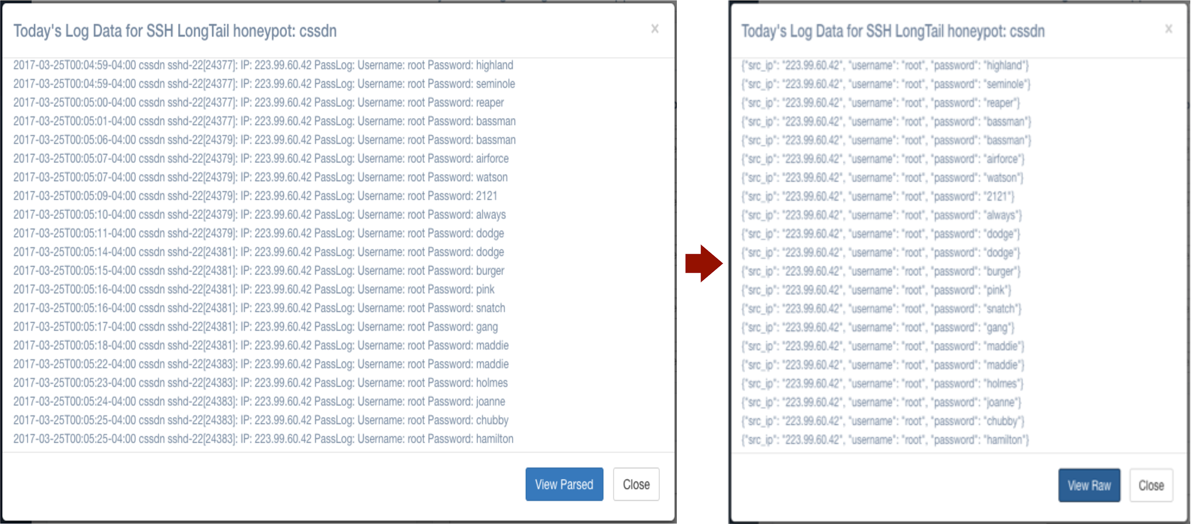
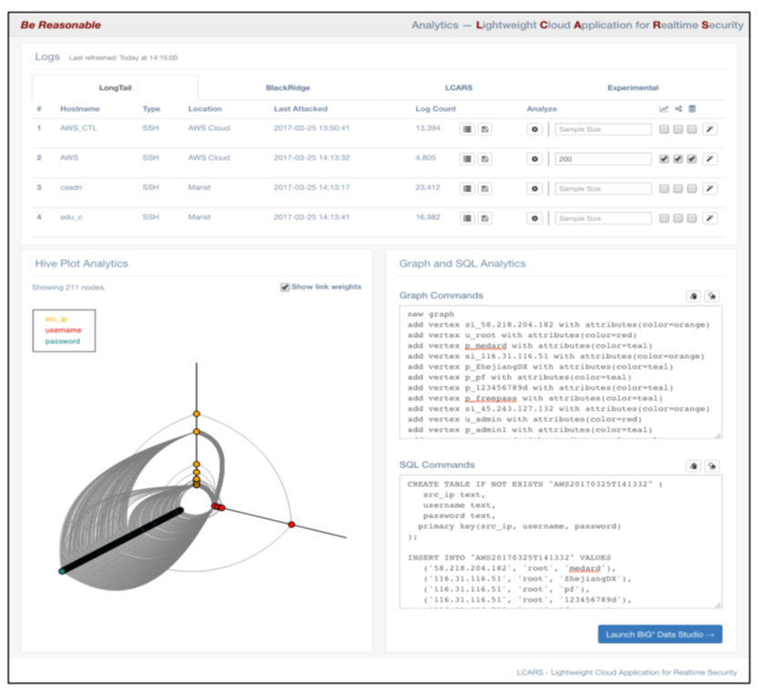

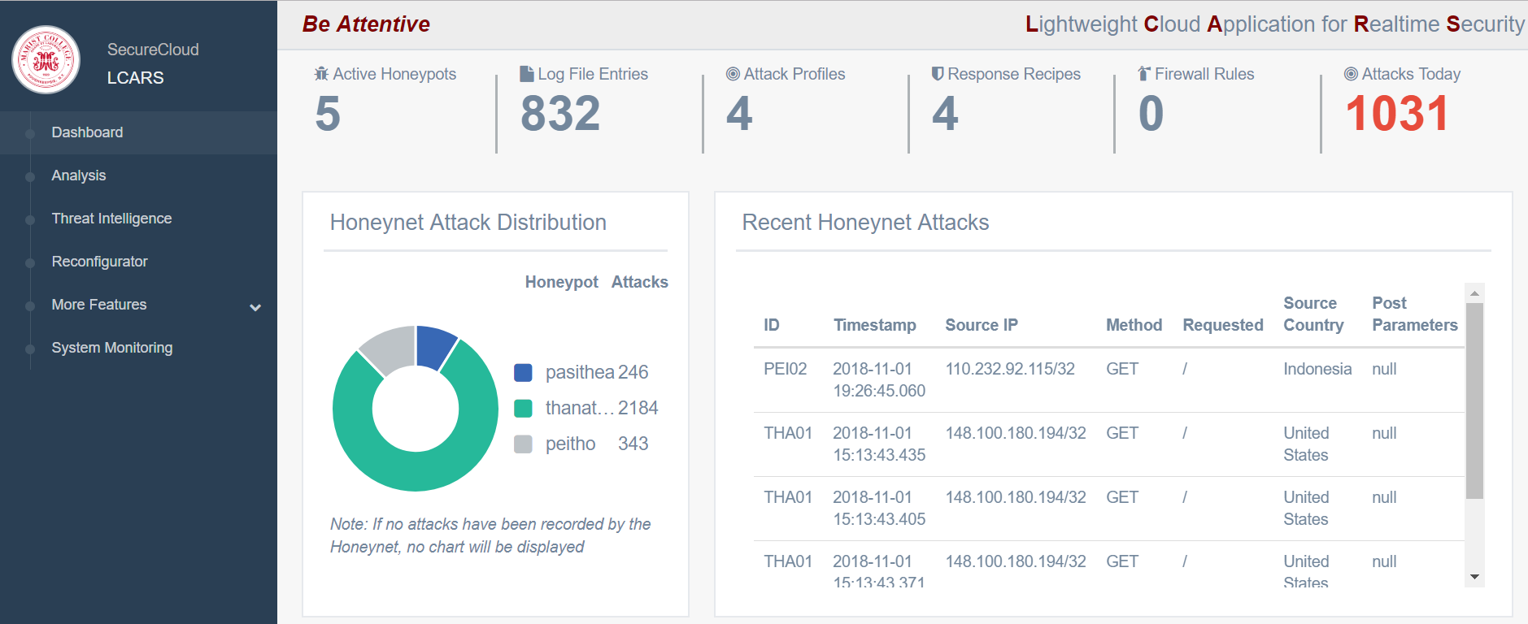
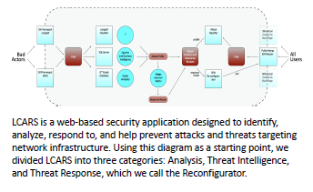
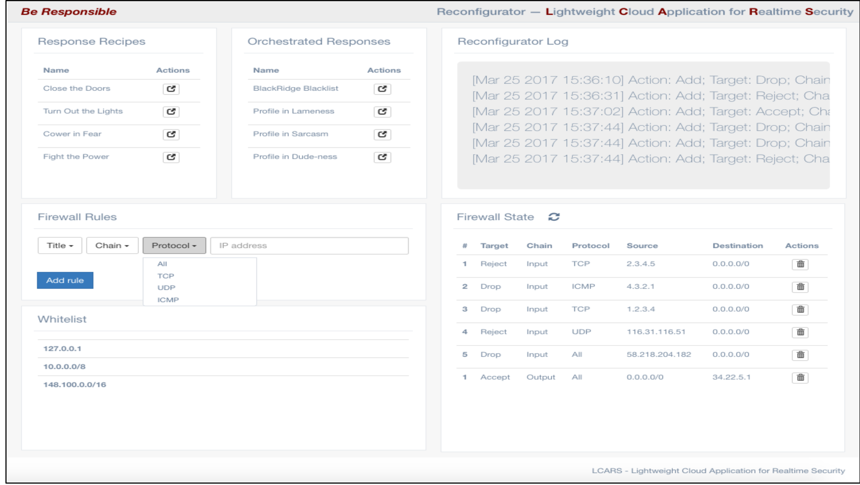
Lightweight Cloud Application for Realtime Security
Honeypot Log Parser
Analytics with Hive plots
Reconfigurator / Orchestrator

Slide 18
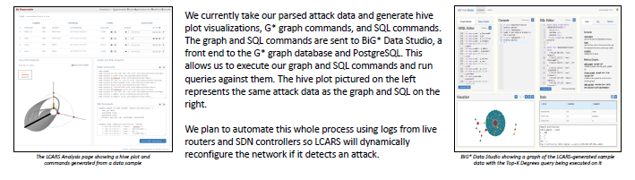
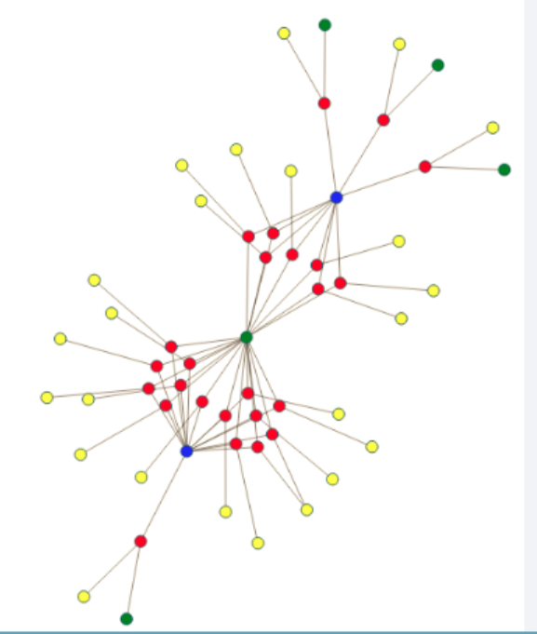

Slide 19
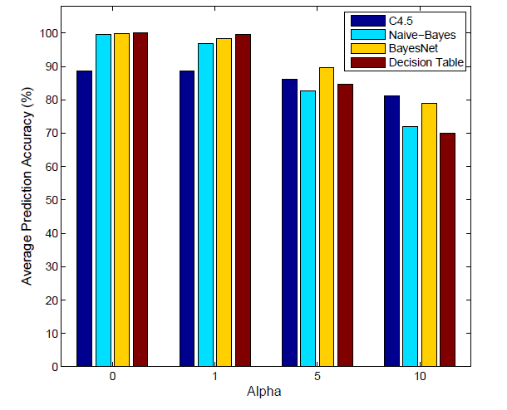
Machine Learning
Used to predict future attacks based on historical data
Alpha = minimum threshold probability required for a resource to be considered vulnerable
Prediction accuracy of different algorithms for different values of alpha
S. Nanda, F. Zafari, C. DeCusatis, E. Wedaa and B. Yang, “Predicting Network Attack Patterns in SDN using Machine Learning Approach”, Proc. IEEE 2016 Conference on Network Function Virtualization and Software Defined Networks (SDN/NFV 2016), Palo Alto, CA (Nov. 7-9, 2016) http://nfvsdn2016.ieee-nfvsdn.org/

Slide 20
Trust Level | Policy
5 | Forward
4 | Restricted Apps
3 | Redirect
2 | Drop
LCARS SOC LAMP Orchestrator
10G Optical Bypass Switch
Marist LongTail & Honeypots (SSH, SDN,API)
SDN Controller Cloaked
External Threat
BlackRidge FPA with TAC Dynamic Trust Levels
WDM Node C
WDM Node B
Brocade/Vyatta 5600
RFW open source firewall Cisco routers
Untrusted Network
With Ciena Metro Ethernet & WDM
Internal Threat
Blockchain Hyperledger
Authorized User
WDM Node A

Slide 21

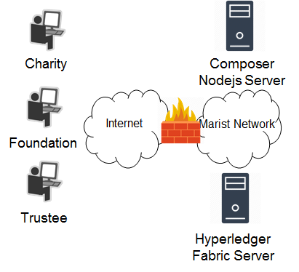
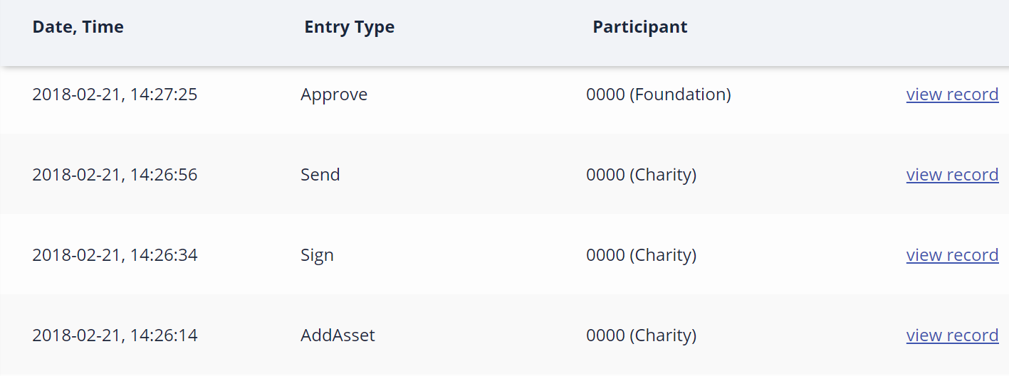


BlackRidge BlockChain Charity Network
Uses Hyperledger Fabric and Composer to create a reliable, secure way for Foundations to give grants to Non-Profits (prevents $40 B / year loss to groups which can least afford it)
Every action creates a new block in the Blockchain that cannot be modified, as pictured below
Both the Trustee and the Non-Profit must verify work complete before the Foundation can pay the grant
C. DeCusatis, M. Zimmerman, and A. Sager, “Identity based network security for
commercial Blockchain services“, Proc. 8th annual IEEE Computing and
Communications Workshop and Conference, Las Vegas, NV (January 8-10, 2018)

Slide 22
Trust Level | Policy
5 | Forward
4 | Restricted Apps
3 | Redirect
2 | Drop
LCARS SOC LAMP Orchestrator
10G Optical Bypass Switch
Marist LongTail & Honeypots (SSH, SDN,API)
SDN Controller Cloaked
External Threat
BlackRidge FPA with TAC Dynamic Trust Levels
WDM Node C
WDM Node B
Brocade/Vyatta 5600
RFW open source firewall Cisco routers
Untrusted Network
With Ciena Metro Ethernet & WDM
Internal Threat
Blockchain Hyperledger
Authorized User
WDM Node A

Slide 23

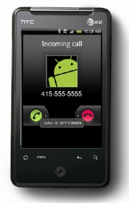
Identity-Based Network Security for the Cloud: First Packet Authentication & Transport Access Control
Networks do not allow for user or device identity to be determined before establishing network connections
BlackRidge Transport Access Control (TAC) authenticates identity and enforces security policy on the first packet, before a network session is established
Caller-ID for the Internet
First Packet Authentication
Before caller-ID, you needed to answer to determine identity.
Session
Setup
First Packet Authentication stops unauthorized access at the earliest possible time.
Current security products start after network sessions are established.
After caller-ID, you only answer authenticated and authorized callers.
Data
Packet Flows
time

Slide 24
IBM LinuxOne Community Cloud
In August 2015, IBM announced a series of enterprise-class Linux servers
In order to promote development and research on this platform, the Linux One Community Cloud makes it possible for anyone to request a free instance of the Linux One servers and toolsets.
This environment is hosted at the New York State Center for Cloud Computing and Analytics (CCAC) at Marist College. Users connect to the cloud via a secure Internet portal to an Apache web server at the Marist College data center, where applications are hosted on virtual machines (VMs) partitioned in an IBM z Systems 113 enterprise server.
To authenticate traffic between these two data centers, BlackRidge appliances implementing TAC and first packet authentication were implemented.
A physical appliance was installed at the edge of the IBM Poughkeepsie data center network, and a virtual appliance hosted in an IBM z13 enterprise server Zvm virtual partition was installed at the corresponding edge of the Marist College data center network

Slide 25
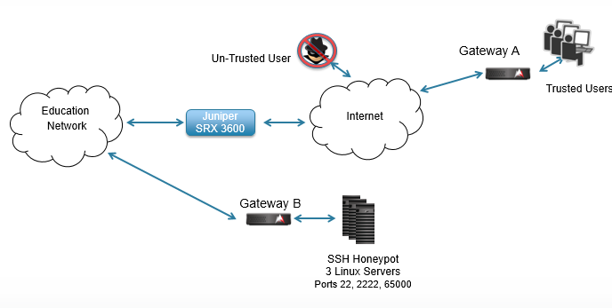
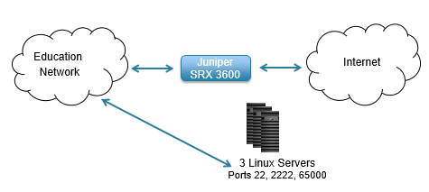
Conventional Network IPS
BlackRidge TAC Gateway

Slide 26
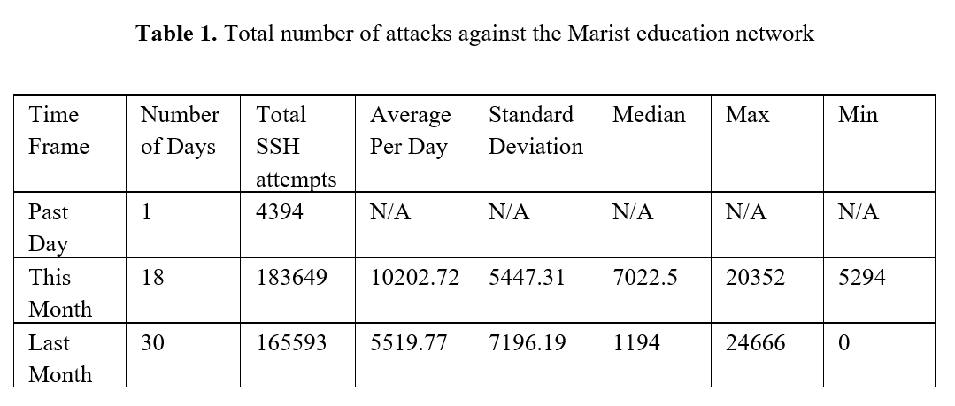
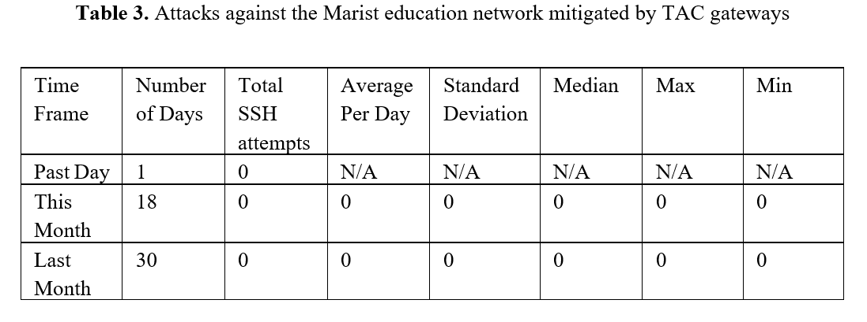
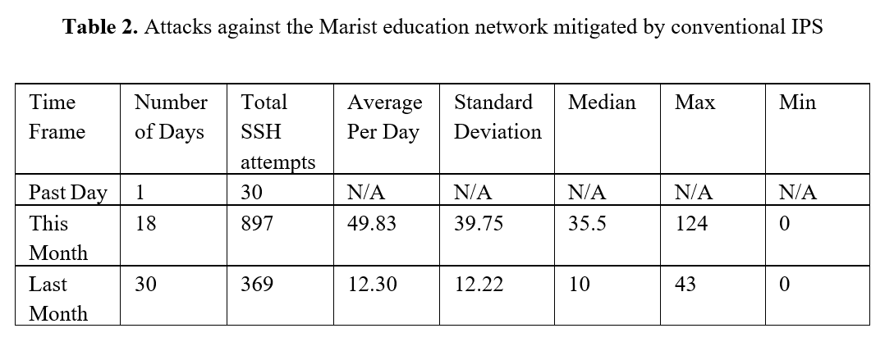

Slide 27
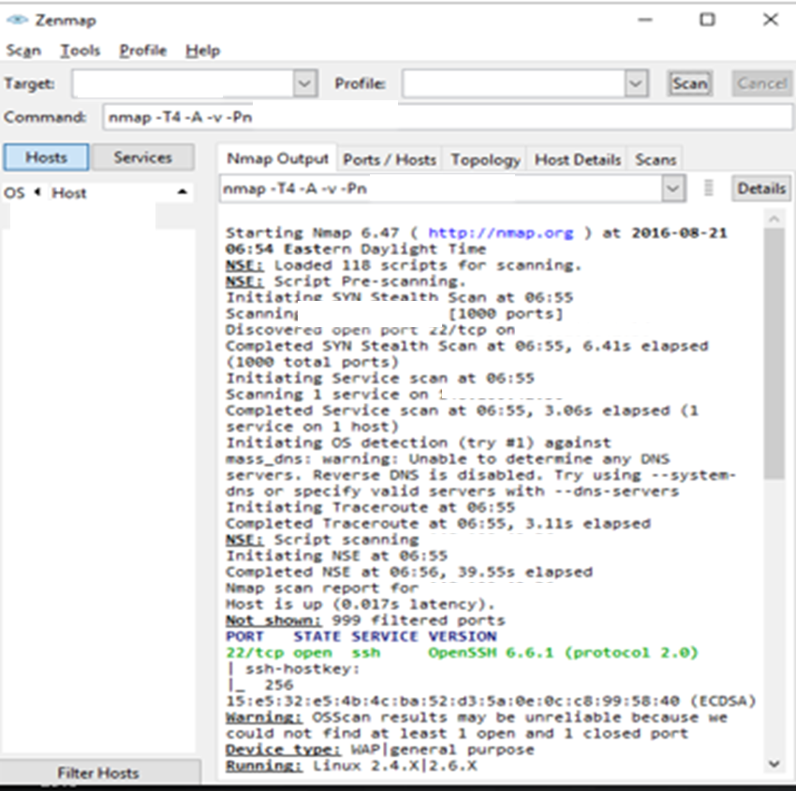
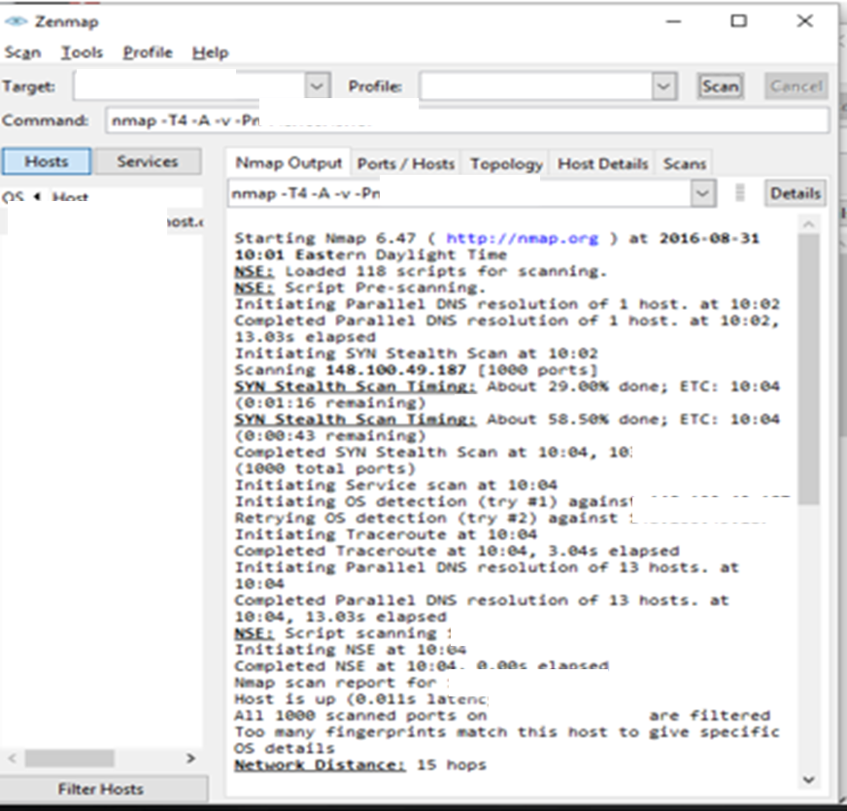
Network scan before & after implementing TAC
open port 22 on the Marist network, running OpenSSH 6.6.1, and a traceroute showing network hops within the IBM network are blocked by TAC gateways, which prevent fingerprinting of the LinuxOne cloud

Slide 28
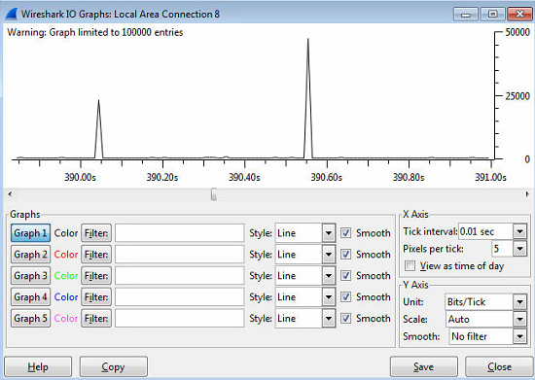
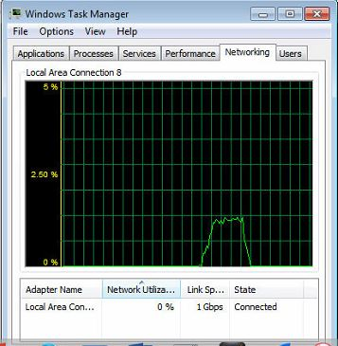
Marist BlackRidge Syslog Rate testing 10 messages 5 sec rate limit 5 Mbps no rate limit 14 Mbps
50,000 bits in 0.01 sec, 100 x 50,000=5,000,000 bps = 5 megabits / sec
1.4% of 1gig = 14 megabits / sec

Slide 29


Marist BlackRidge Protect Against Insider Threats
After 3 unauthorized attempts,
Trusted traffic is discarded
A BlackRidge Trusted user with identity attempts to access a server it is not authorized for
Trustedad Group trustedad
Protected29 Group trustedad
Gateway4
Port 1 Port 2
Gateway5
Port 1 Port 2
Marist
Network
Management
Port 4
Management
Port 4
Level | Policy
5 | Forward
4 | Restricted Applications
3 | Redirect
2 | Drop
BlackRidge Gateway sends Unauthorized Syslog entry to Graylog
Orchestrator calls Gateway REST API to lower trust level by 1
Resource not authorized for user Trustedad
Graylog HTTP POST alert message to Orchestrator
Orchestrator
Notes:
**This slide contains animations

Slide 30
A BlackRidge Trusted user with identity attempts to access a server it is not authorized for
Trusted Group trusted
Protected29 Group trustedad
Gateway4
Port 1 Port 2
Gateway5
Port 1 Port 2
Marist
Network
Management
Port 4
Management
Port 4
BlackRidge Gateway sends Unauthorized Syslog entry to Graylog
Level | Policy
5 | Forward
4 | Restricted Applications
3 | Redirect
2 | Drop
Orchestrator calls Gateway REST API to lower trust level by 1
Graylog HTTP POST alert message to Orchestrator
First Packet Authentication Transport Access Control Dynamic Trust Level Insider Threats
Orchestrator
Notes:
**This slide contains animationsh

Slide 31
Trust Level | Policy
5 | Forward
4 | Restricted Apps
3 | Redirect
2 | Drop
LCARS SOC LAMP Orchestrator
10G Optical Bypass Switch
Marist LongTail & Honeypots (SSH, SDN,API)
SDN Controller Cloaked
External Threat
BlackRidge FPA with TAC Dynamic Trust Levels
WDM Node C
WDM Node B
Brocade/Vyatta 5600
RFW open source firewall Cisco routers
Untrusted Network
With Ciena Metro Ethernet & WDM
Internal Threat
Blockchain Hyperledger
Authorized User
WDM Node A
Notes:
Four key points: 1) SOC orchestration 2) Blockchain 3) insider threats
4) External threats: Bleichenbacher, Memcached

Slide 32
Bleichenbacher Attacks
Vulnerable hosts relying on RSA encryption key exchanges are exposed to attackers passively recording traffic for later decryption. Discrepancies in Transport Layer Security (TLS) error messages allow attackers to obtain the private RSA key used by TLS to decrypt sensitive data.
When the vulnerability was first disclosed, the designers of TLS chose to keep the vulnerable encryption modes in service and add countermeasures, which themselves were later found to be incomplete, necessitating the deployment of increasingly complicated countermeasures which are often not implemented properly.

Slide 33
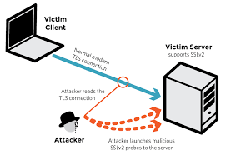
Bleichenbacher Attacks
There are many variations on this approach
Hosts using forward secrecy remain vulnerable to a server impersonation or man-in-the-middle version of the attack
Similar vulnerabilities in XML encryption, S/MIME, Java Object Signing and Encryption (JOSE), and other approaches persist even within large organizations such as Facebook and PayPal
ROBOT attack against HTTPS hosts
JSEE timing attacks
Cross-protocol attacks against TLS 1.3
The so-called DROWN attack is a protocol level Bleichenbacher vulnerability in SSL version 2

Slide 34
BlackRidge Demonstration
Port scanning and access, DOS and DDOS attacks on TLS ports are eliminated
Eliminate Bleichenbacher-style attacks http://www.kb.cert.org/vuls/id/144389. An attacker may utilize discrepancies in TLS error messages to obtain the pre-master secret key private RSA key used by TLS to decrypt sensitive data
Unauthorized access because of a compromised keys is eliminated. Only the person with the appropriate key on a specific computer can access the Blockchain
Protects against Insider Threats, An authorized member of blockchain 1 cannot access blockchain 2 resources
Trustee Group trusted
nodejs Group trusted
Hyperledger Fabric
Gateway4
Port 1 Port 2
Untrusted
Gateway5
Port 1 Port 2
Marist
Network
Management
Port 4
Management
Port 4

Slide 35
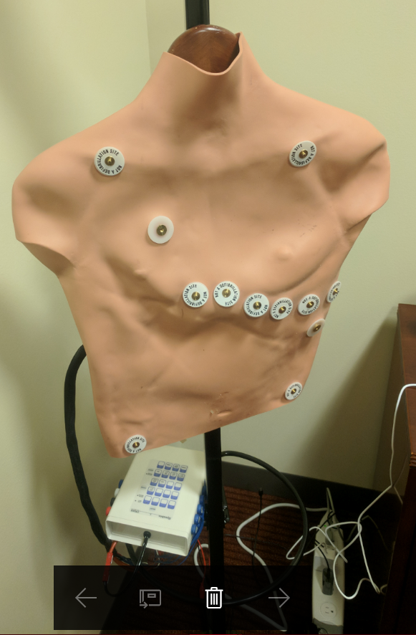

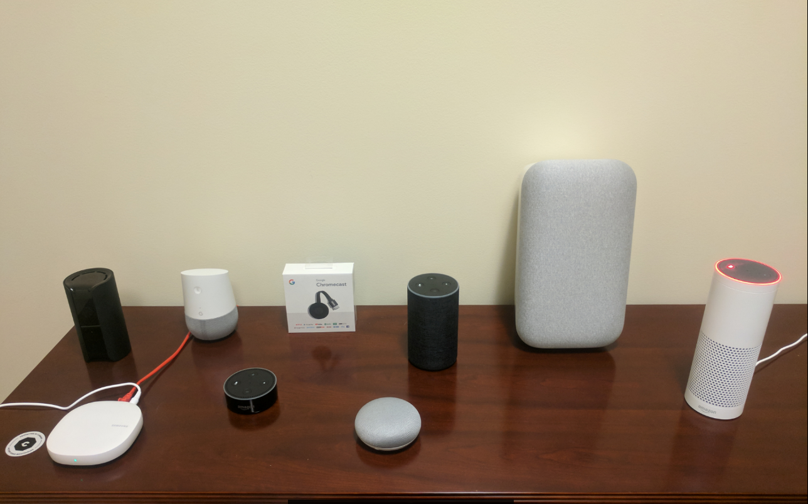
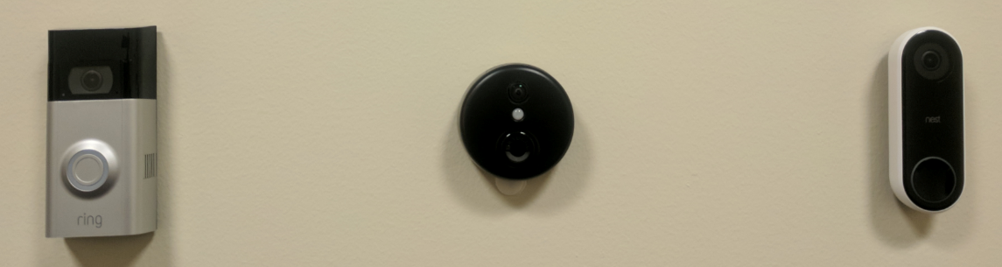
Future Directions: Internet of Things (IoT) Research Lab
Cybersecurity research including:
Smart homes & speech recognition (Google Home, Amazon Alexa)
Digital health care & remote patient monitoring (heart rate, blood pressure, blood oxygen, and more)
Routers, Hubs, and Security Appliances
Hardware & Software Design (Arduino, Raspberry Pi)
Networked Devices (smart light bulbs, vacuum cleaners, doorbells, thermostats, wall outlets, air quality monitors)
Wireless penetration testing (AirPCap, Wifi Pineapple, RFID tags, botnets)

Slide 36
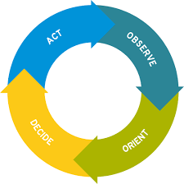
Conclusions
Bad Actors / Attack Surface
Autonomic methods can be used to improve cybersecurity defenses (OODA loop)
DDoS with malware insertion
Reconnaissance scans (FPA, TAC)
Bleichenbach style internal threats
Dynamic trust level adjustment
We have developed & demonstrated building blocks of a zero trust infrastructure, integrated with Marist SOC (LCARS and commercial products from IBM and Cisco)
Future work includes additional machine learning analytics, driven by larger honey farms with SDN enablement
Raw Data Telemetry Collection (big data + metadata honeypots)
Cloaked Resources
Classification Attribution Visualization Analytics
Data Analysis
(LCARS, Gstar, SOC)
Actionable Threat Intelligence (attack profile, response recipe)
Autonomic Defense (Reconfigurator / Orchestrator)

Slide 37
Thank You
Follow @Dr_Casimer or http://www.ofcconference.org/en-us/home/about/ofc-blog/
or visit the Marist Innovation Lab on GitHub: https://github.com/Marist-Innovation-Lab

Slide 38
Conference Presentations
M. Molenaer, M. Barbieri, V. Joseph, M. Crawley, and P. Liengtiraphan, “Zero Trust Networks using Transport Access Control Techniques” Proc. IBM TechConnect (Best of Solutions Award, Early Tenure Category), IBM Poughkeepsie/Yorktown Heights, NY (September 22, 2016)
P. Liengtiraphan and C. DeCusatis, “Zero Trust Networks using Transport Access Control and First Packet Authentication”, Proc. NYIT 6th Annual Cybersecurity Conference, New York, NY, student poster session (Sept. 22, 2016) http://www.nyit.edu/events/annual_cybersecurity_conference
C. DeCusatis, “Cloudy with a chance of SDN Part II”, BRKCRT-2603, Cisco Live, Las Vegas, NV (July 10-15, 2016)
C. DeCusatis, “The NSF SecureCloud project: cybersecurity for enterprise class data centers”, Proc. NSF Enterprise Computing Conference (ECC), Marist College, Poughkeepsie, NY, June 12-14, 2016
C. DeCusatis, “Zero trust cybersecurity architectures for software defined data centers”, Proc. NYSERNET (Internet 2) Tech Summit, Vassar College, Poughkeepsie, NY June 16-17, 2016
R. Cannistra, P. Liengtiraphan, and V. Joseph, "Securing SDN and NFV Enabled Campus Environments through Orchestration and Automation", Proc. Internet 2 Technology Exchange, Miami, FL (September 2016)
P. Liengtiraphan and V. Joseph, “How to make a honeypot”, lightning talk presented at Internet 2 Technology Exchange, Miami, FL (September 2016)

Slide 39
Conference Presentations
C. DeCusatis, D. Eidle, S. Ni, B. Ross, M. Miller, and B. Traditi, “Autonomic security: real time response to cybersecurity threats”, Proc. NYIT 7th Annual Cybersecurity Conference, New York, NY (Sept. 23, 2017) http://www.nyit.edu/events/annual_cybersecurity_conference (last accessed September 2017)
C. DeCusatis, A. Labouseur, T. Famularo, J. Heiden, G. Leaden, T. Magnusson, and M. Zimmermann, “An API Honeypot for DDoS and XSS Analysis”, Proc. NYIT 7th Annual Cybersecurity Conference, New York, NY; Best Undergraduate Research Paper Award (Sept. 23, 2017) http://www.nyit.edu/events/annual_cybersecurity_conference (last accessed September 2017)
D. Eidle, S. Ni, C. DeCusatis, and A. Sager, “Autonomic security for zero trust networks”, Proc. IEEE 8th annual Ubiquitous Computing, Electronics, and Mobile Communications Conference (UEMCON), Columbia University, New York, NY (Oct. 19-21, 2017)
G. Leaden, M. Zimmermann, C. DeCusatis, and A. Labouseur, “An API Honeypot for DDoS and XSS Analysis”, Proc. IEEE/MIT Undergraduate Research Technology Conference, Cambridge, MA (Nov. 3-5 2017)
C. DeCusatis, M. Zimmerman, and A. Sager, “Identity based network security for commercial Blockchain services“, Proc. 8th annual IEEE Computing and Communications Workshop and Conference, Las Vegas, NV (January 8-10, 2018)

Slide 40
Research Papers
S. Nanda, F. Zafari, C. DeCusatis, E. Wedaa and B. Yang, “Predicting Network Attack Patterns in SDN using Machine Learning Approach”, Proc. IEEE 2016 Conference on Network Function Virtualization and Software Defined Networks (SDN/NFV 2016), Palo Alto, CA (Nov. 7-9, 2016) http://nfvsdn2016.ieee-nfvsdn.org/
C. DeCusatis, P. Liengtiraphan, A. Sager, and M. Pinelli, “Implementing Zero Trust Cloud Networks with Transport Access Control and First Packet Authentication”, Proc. IEEE International Conference on Smart Cloud (SmartCloud 2016), New York, NY (Nov. 18-20, 2016) http://csis.pace.edu/CSCloud/sc2016/
C. DeCusatis, A. Carranza, “Modeling software defined networks using Mininet”, Proc. 2nd International Conference on Computer and Information Science and Technology (CIST), Montreal, Canada (May 20-21, 2016) (Best Paper Award)
C. DeCusatis, K. Lotay, “Secure, decentralized energy resource management using the Ethereum blockchain”, Proc. IEEE Trustcon 2018, International Workshop on Cyber-Physical Systems, pp. 1-7, New York, NY (August 2-5, 2018)
C. DeCusatis, “The NSF SecureCloud project: cybersecurity for autonomic, zero trust networks”, Proc. NSF Internet 2 Cybersecurity Transaction to Practice Workshop, City University of New York, NY (April 17, 2018)

